Slide 1



DIAGRAMS AND CHARTS
A2: BUSINESS ANALYSIS
Team 6
Carlos Santiago Villa Duque
Maureen Andrei Lepatan
Ashley Mathew
Ahmed Saafan
Shih-Hsuan Yan

Slide 2
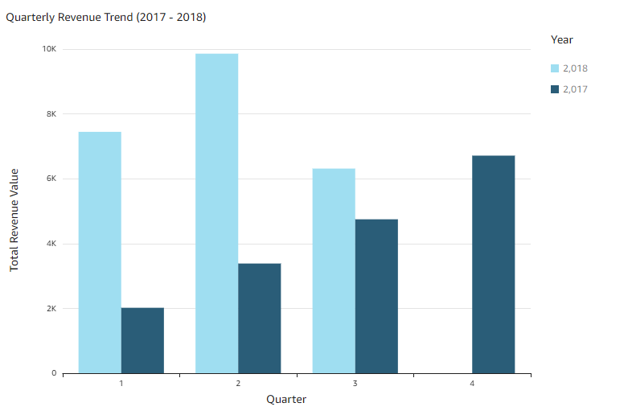
Revenue Trend Analysis
“Quarterly”
There is an overall upward trend in quarterly revenue from 2017 to 2018, indicating business growth
No Seasonal Impact
Issue -> There is a dip in 2018 Q3 Revenues

Slide 3
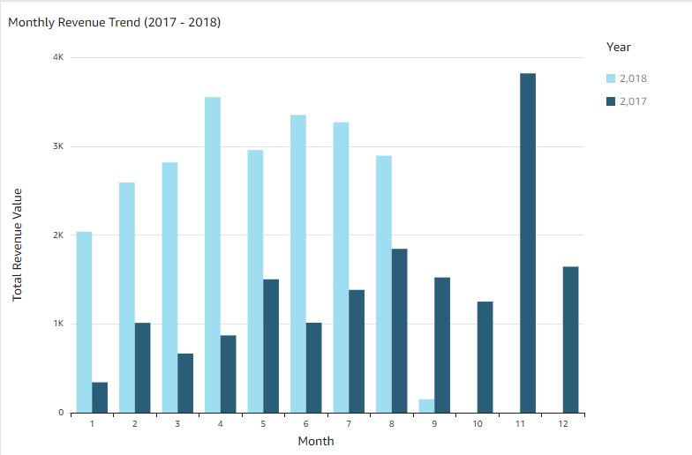
Revenue Trend Analysis
“Monthly”
There is a clear different between the averages of 2017 and 2018
November is an outlier.
A clear dip in 2018 July and August revenues

Slide 4
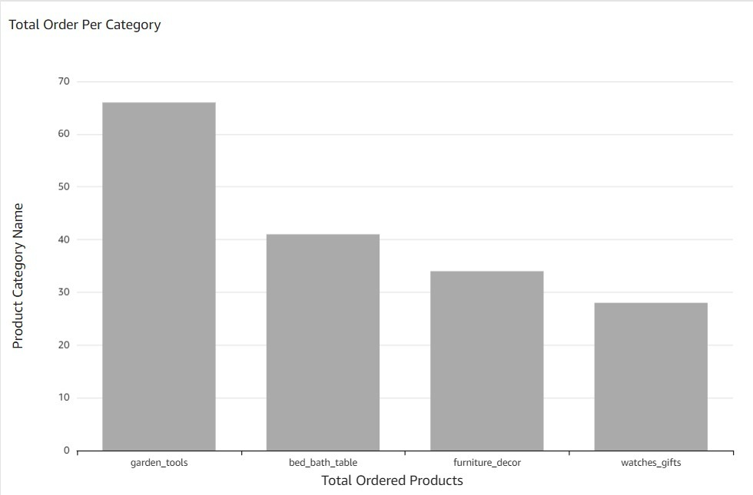
Our Most Sold Products
This could suggest a high demand for garden tools as well as home and bathroom products
Marketing Promotions and Inventory Management will be key

Slide 5
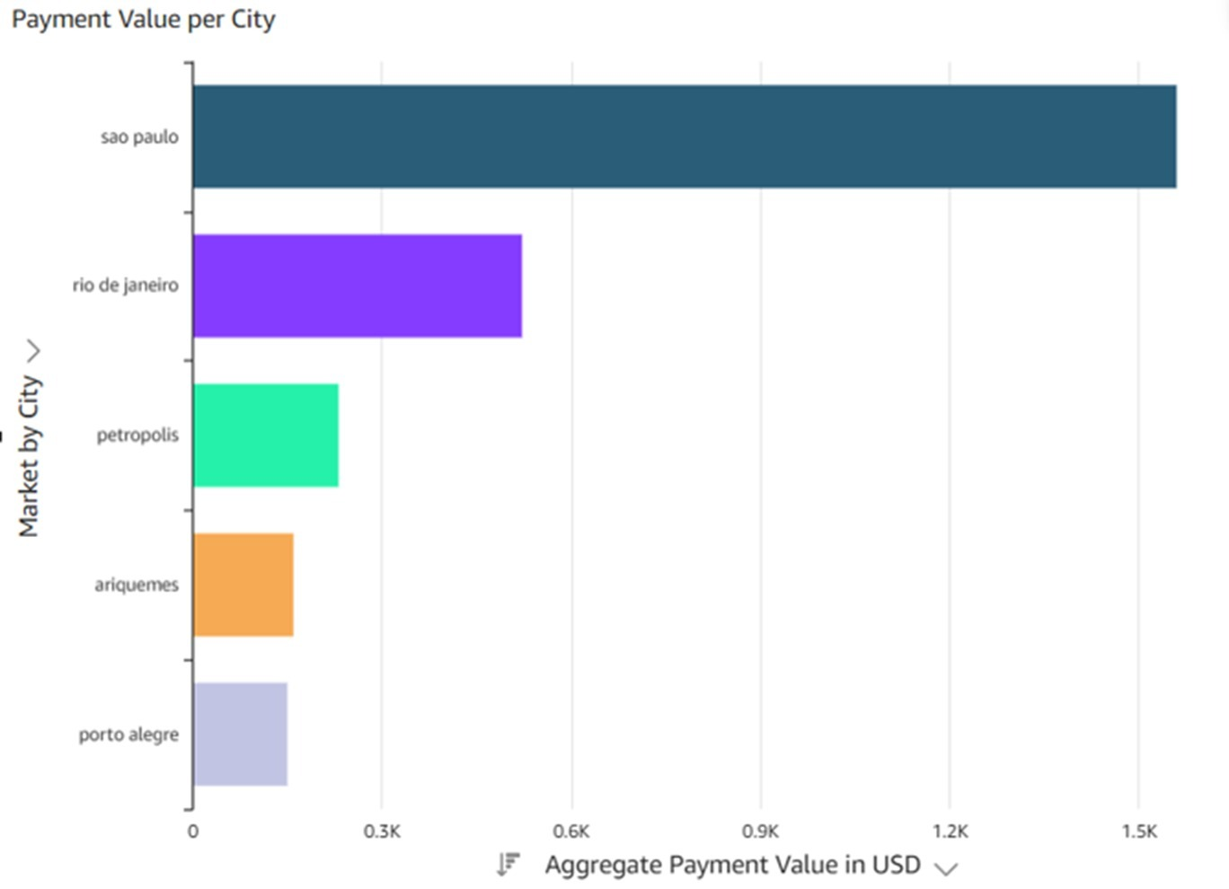
Our Global Reach
São Paulo and Rio de Janeiro stand out as major contributors to the revenue in Brazil
São Paulo is 3X Rio de Janeiro and Rio de Janeiro is 2X Petropolis
The presence of cities like Petrópolis, Ariquemes, and Porto Alegre indicates that the company has a broad reach within Brazil, extending beyond the major urban centers.

Slide 6
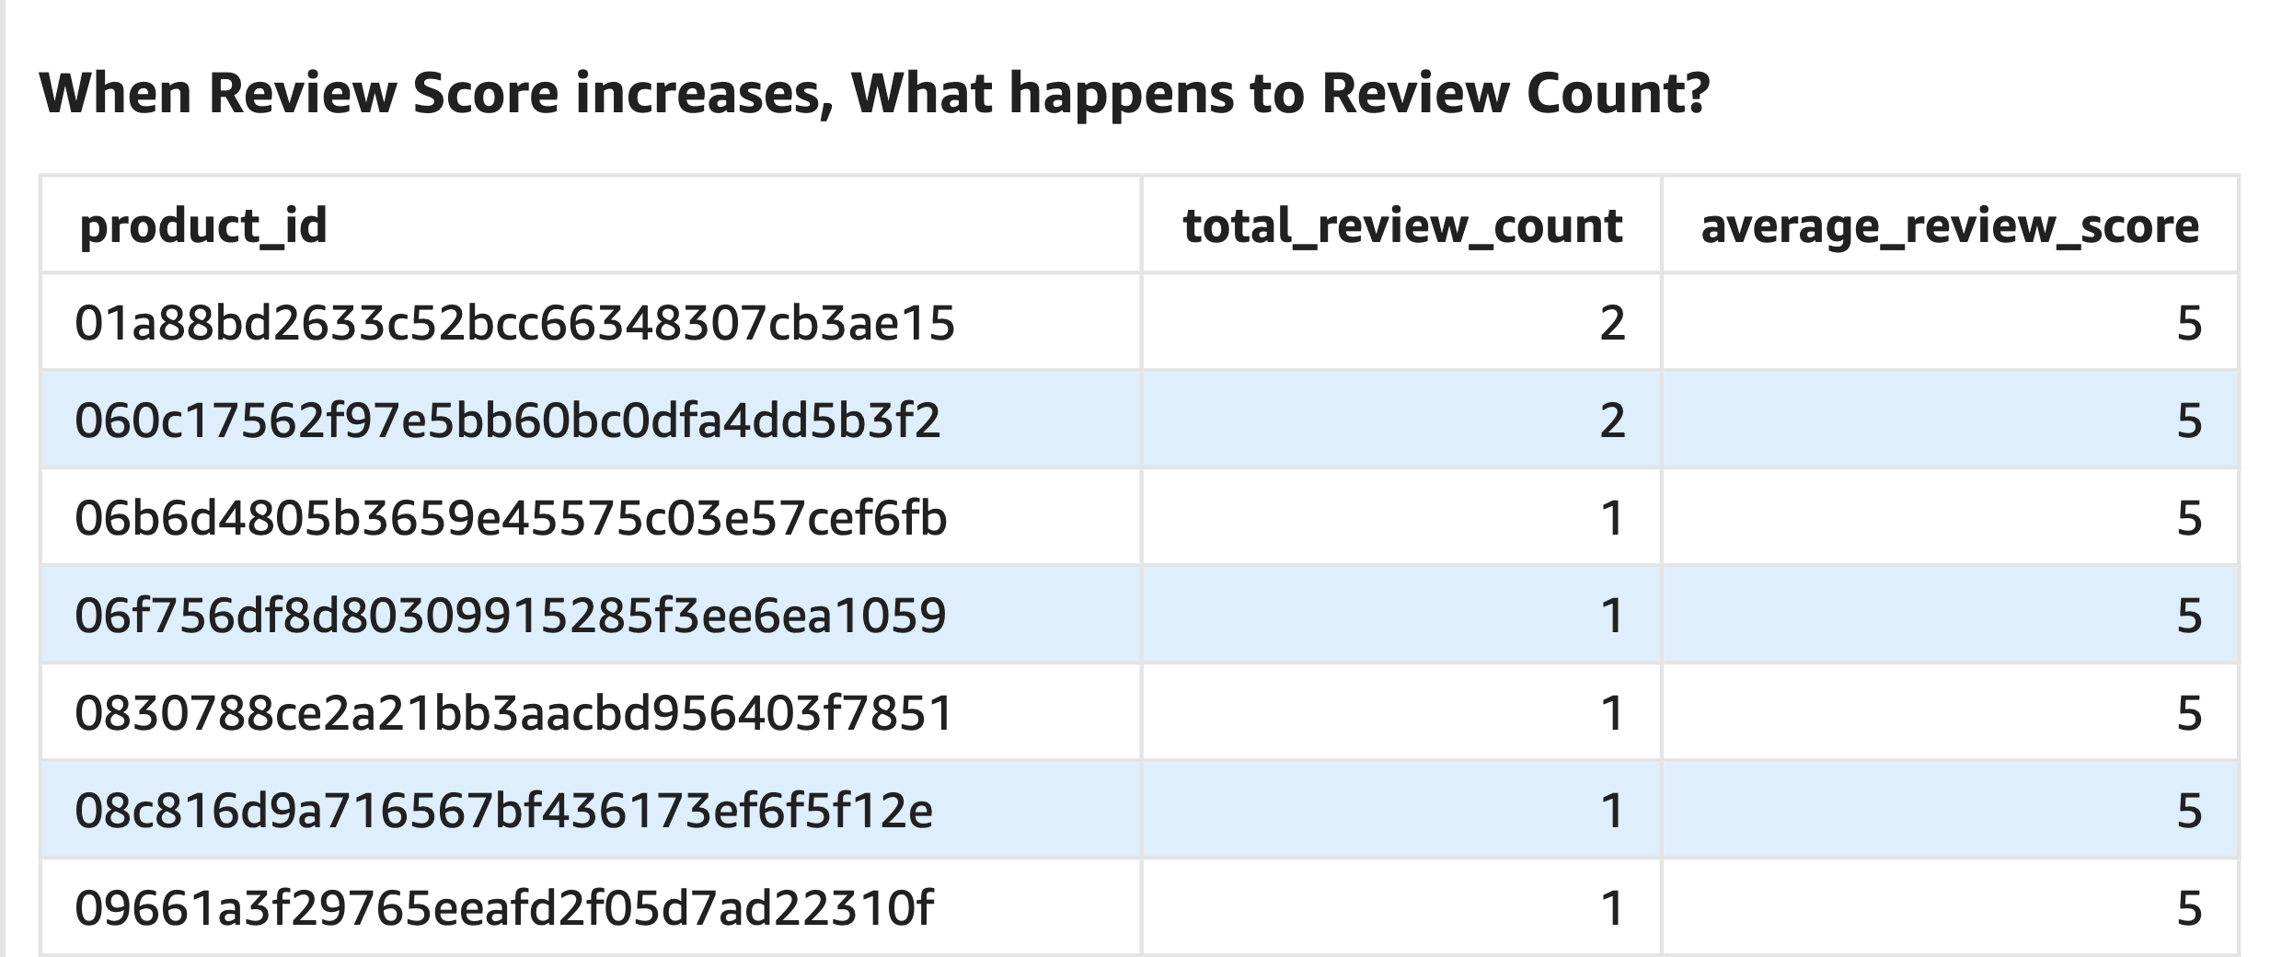
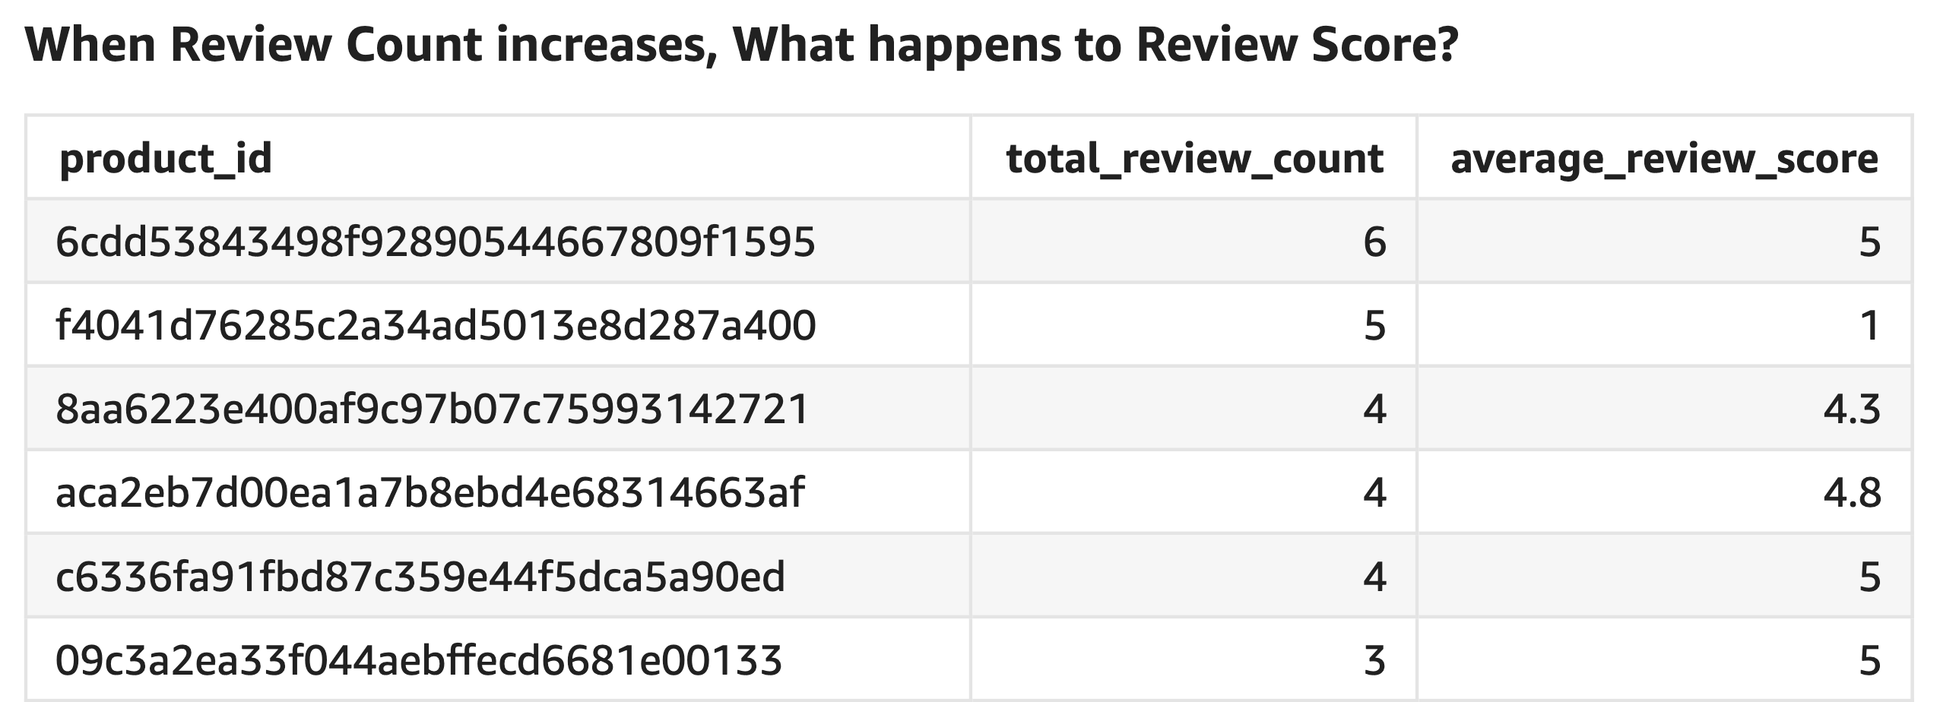
Analyzing Customer Feedback
Relationship Between Review Score and Review Count

Slide 7
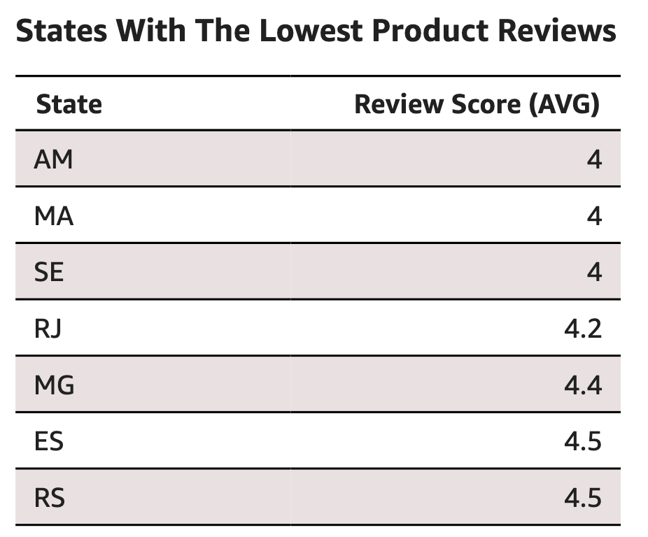
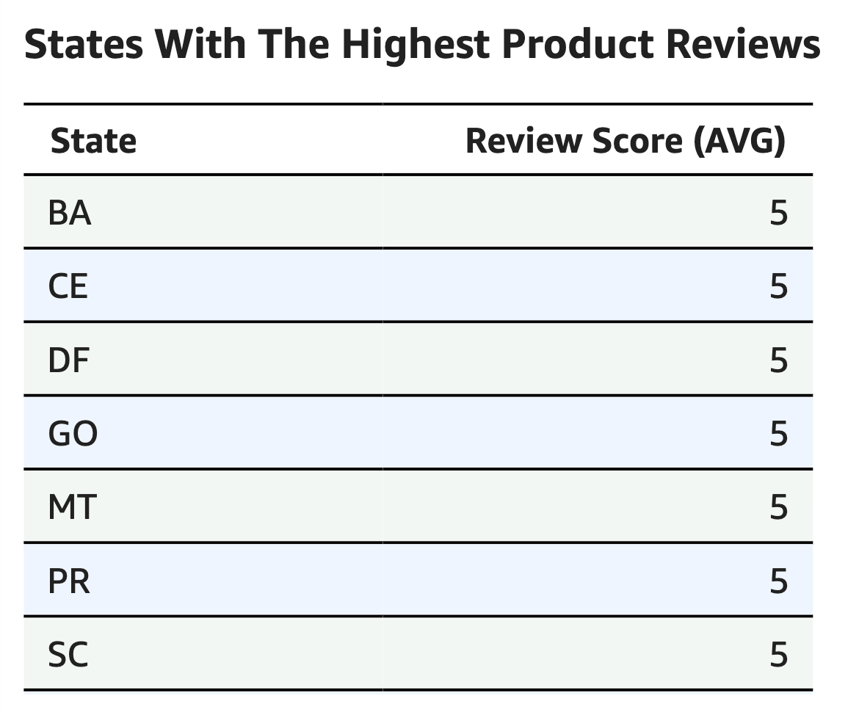
How Are Different States Rating Our Products?
Geographically, states in general have had positive feedback on aggregate when it comes to our product ratings.

Slide 8
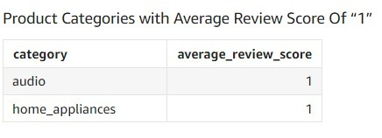
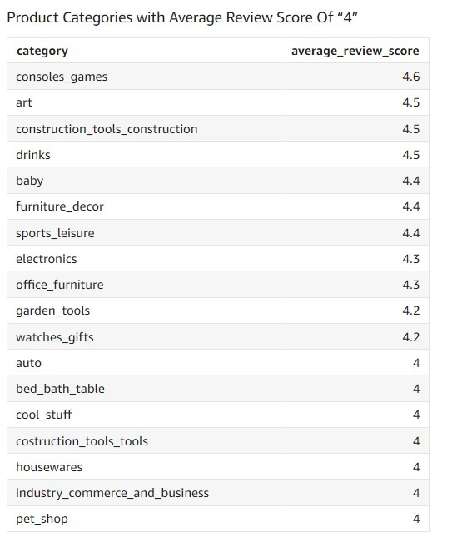
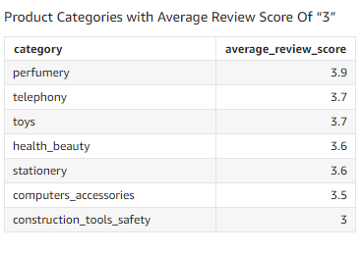
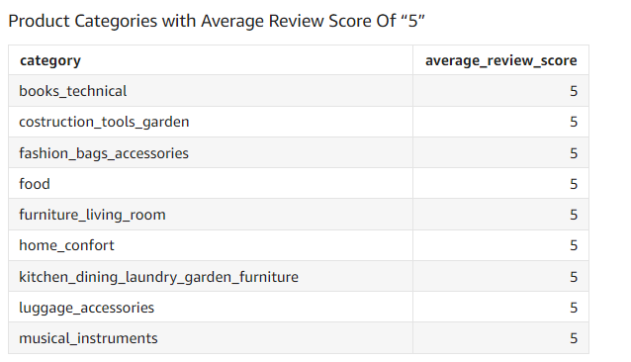
Average Customer Score Per Product Category
Note how there are no reviews with a rating of “2”
Category scores of 1 and 3 need to be addressed as soon as possible

Slide 9
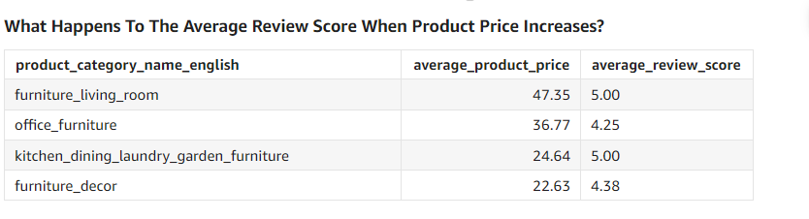
While yes, customers tend to perceive higher priced products to be higher in quality; therefore, influencing their ratings, the data is not conclusive on this as there are some variations like office furniture.

Slide 10
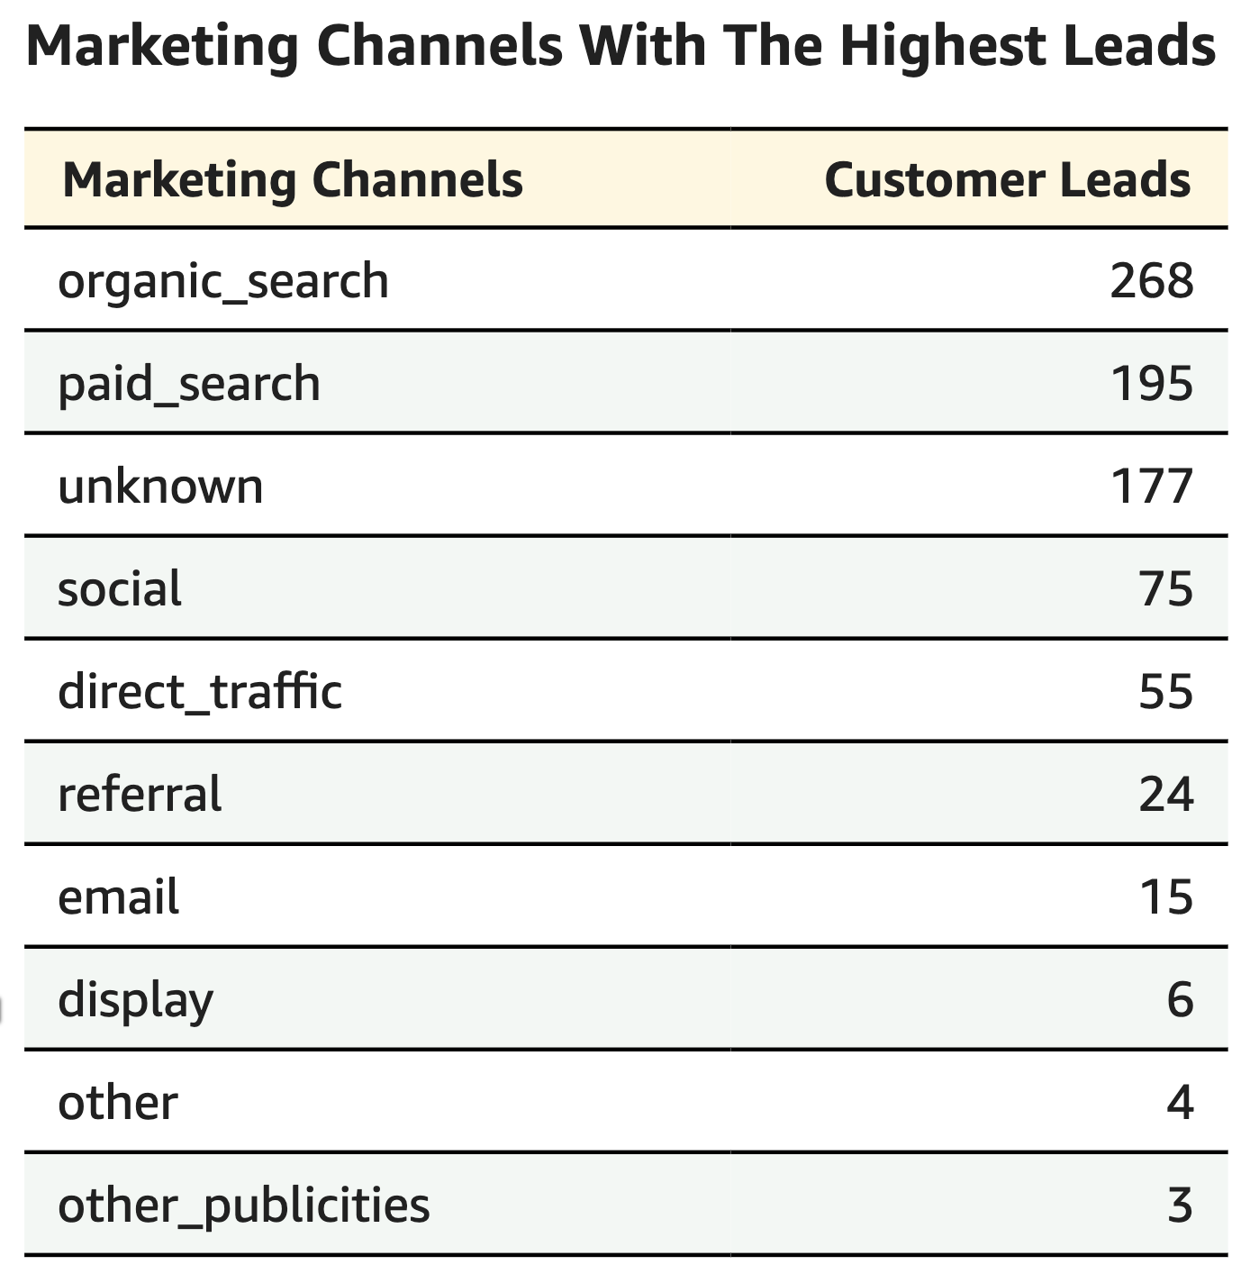
Which Marketing Channels Generate the Most Leads?
Organic Search and Paid Search are our best Marketing tools so far accounting for almost 60% of our total leads generated
The 'unknown' category with 177 leads, could indicate leads from miscellaneous sources or those that were not properly tracked
There is untapped potential when it comes to other useful marketing channels like “email, referral, social, and direct channels”

Slide 11
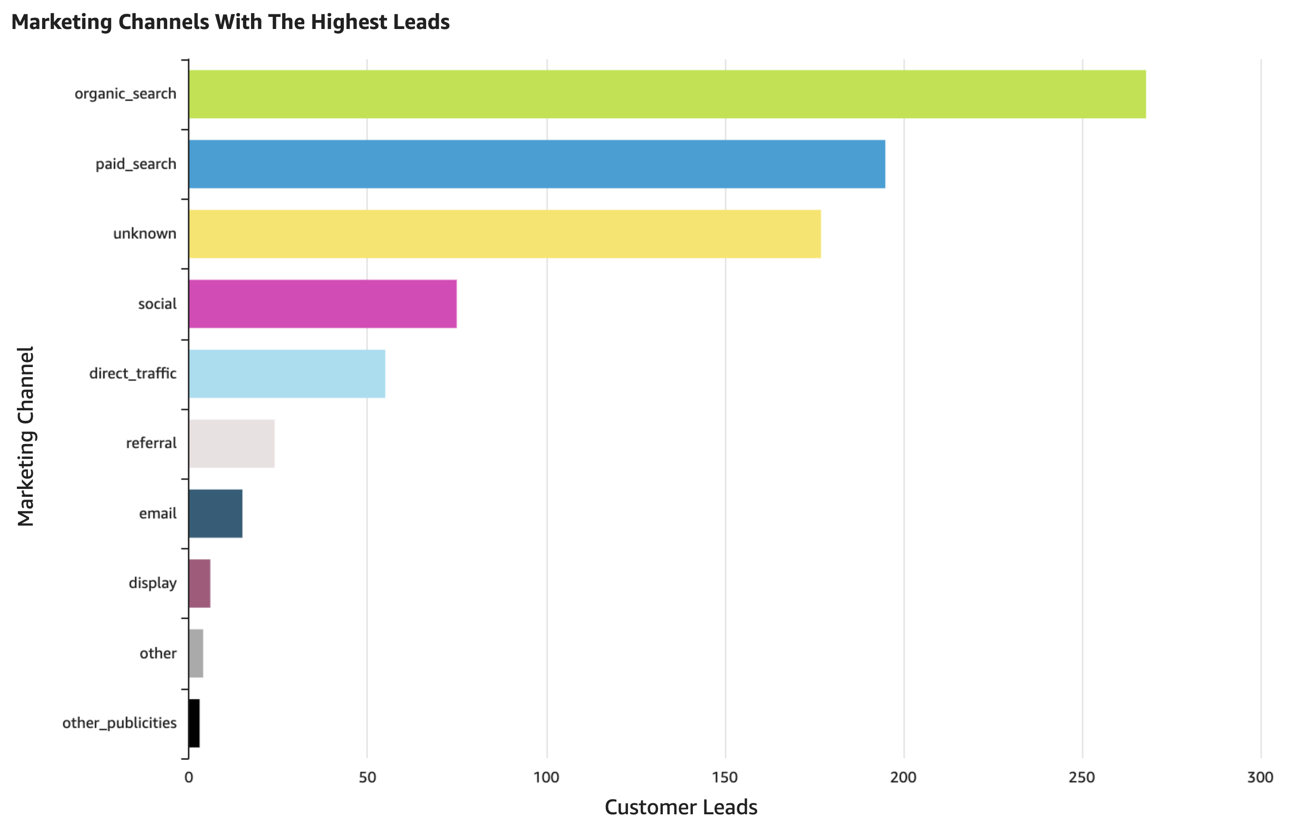

Slide 12
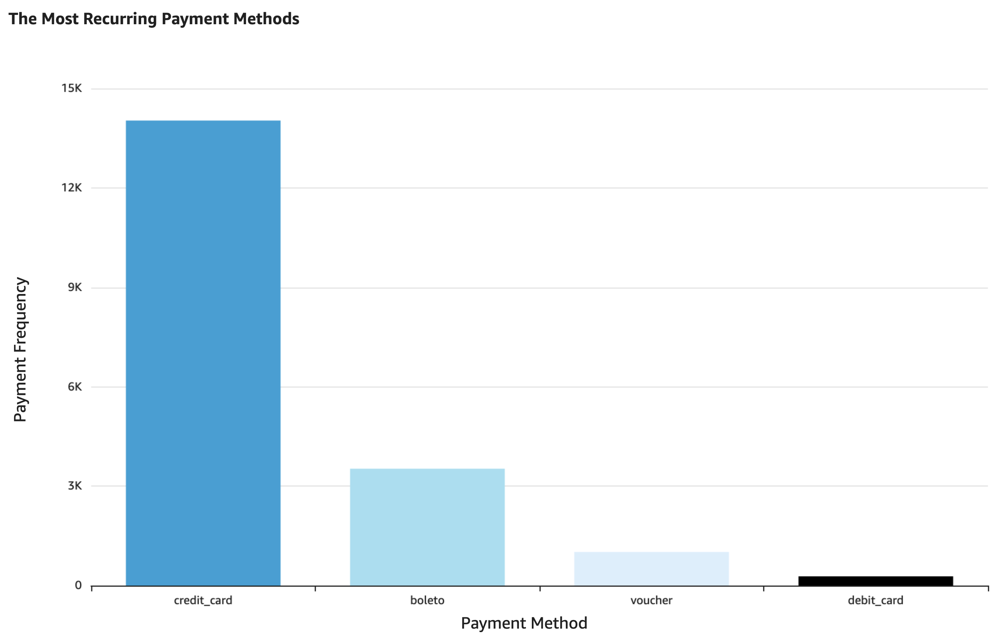
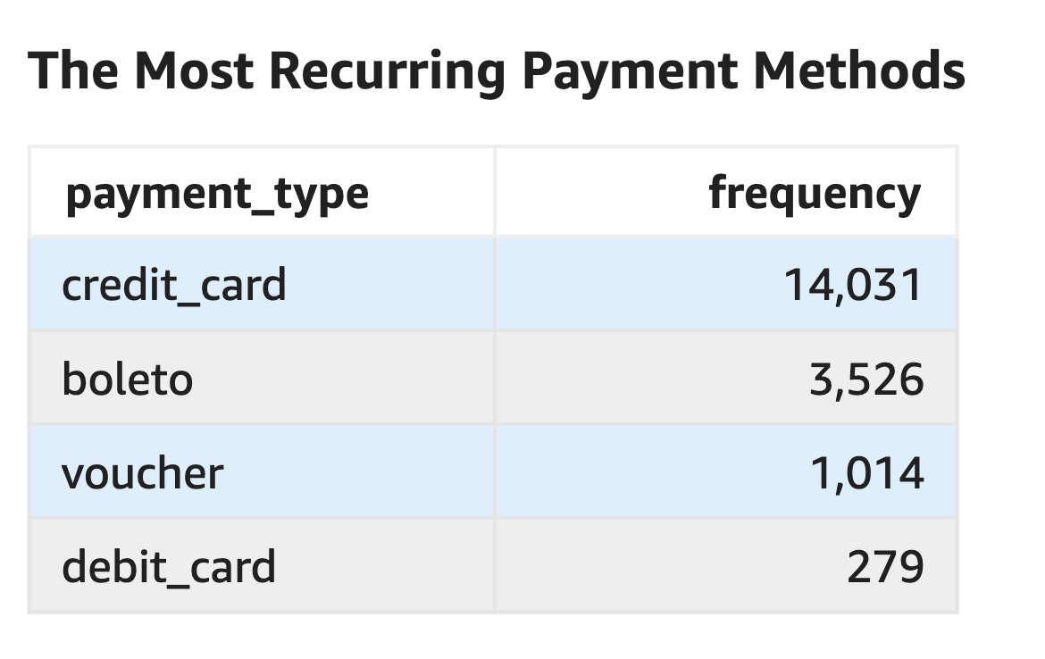
Payment Methods

Slide 13
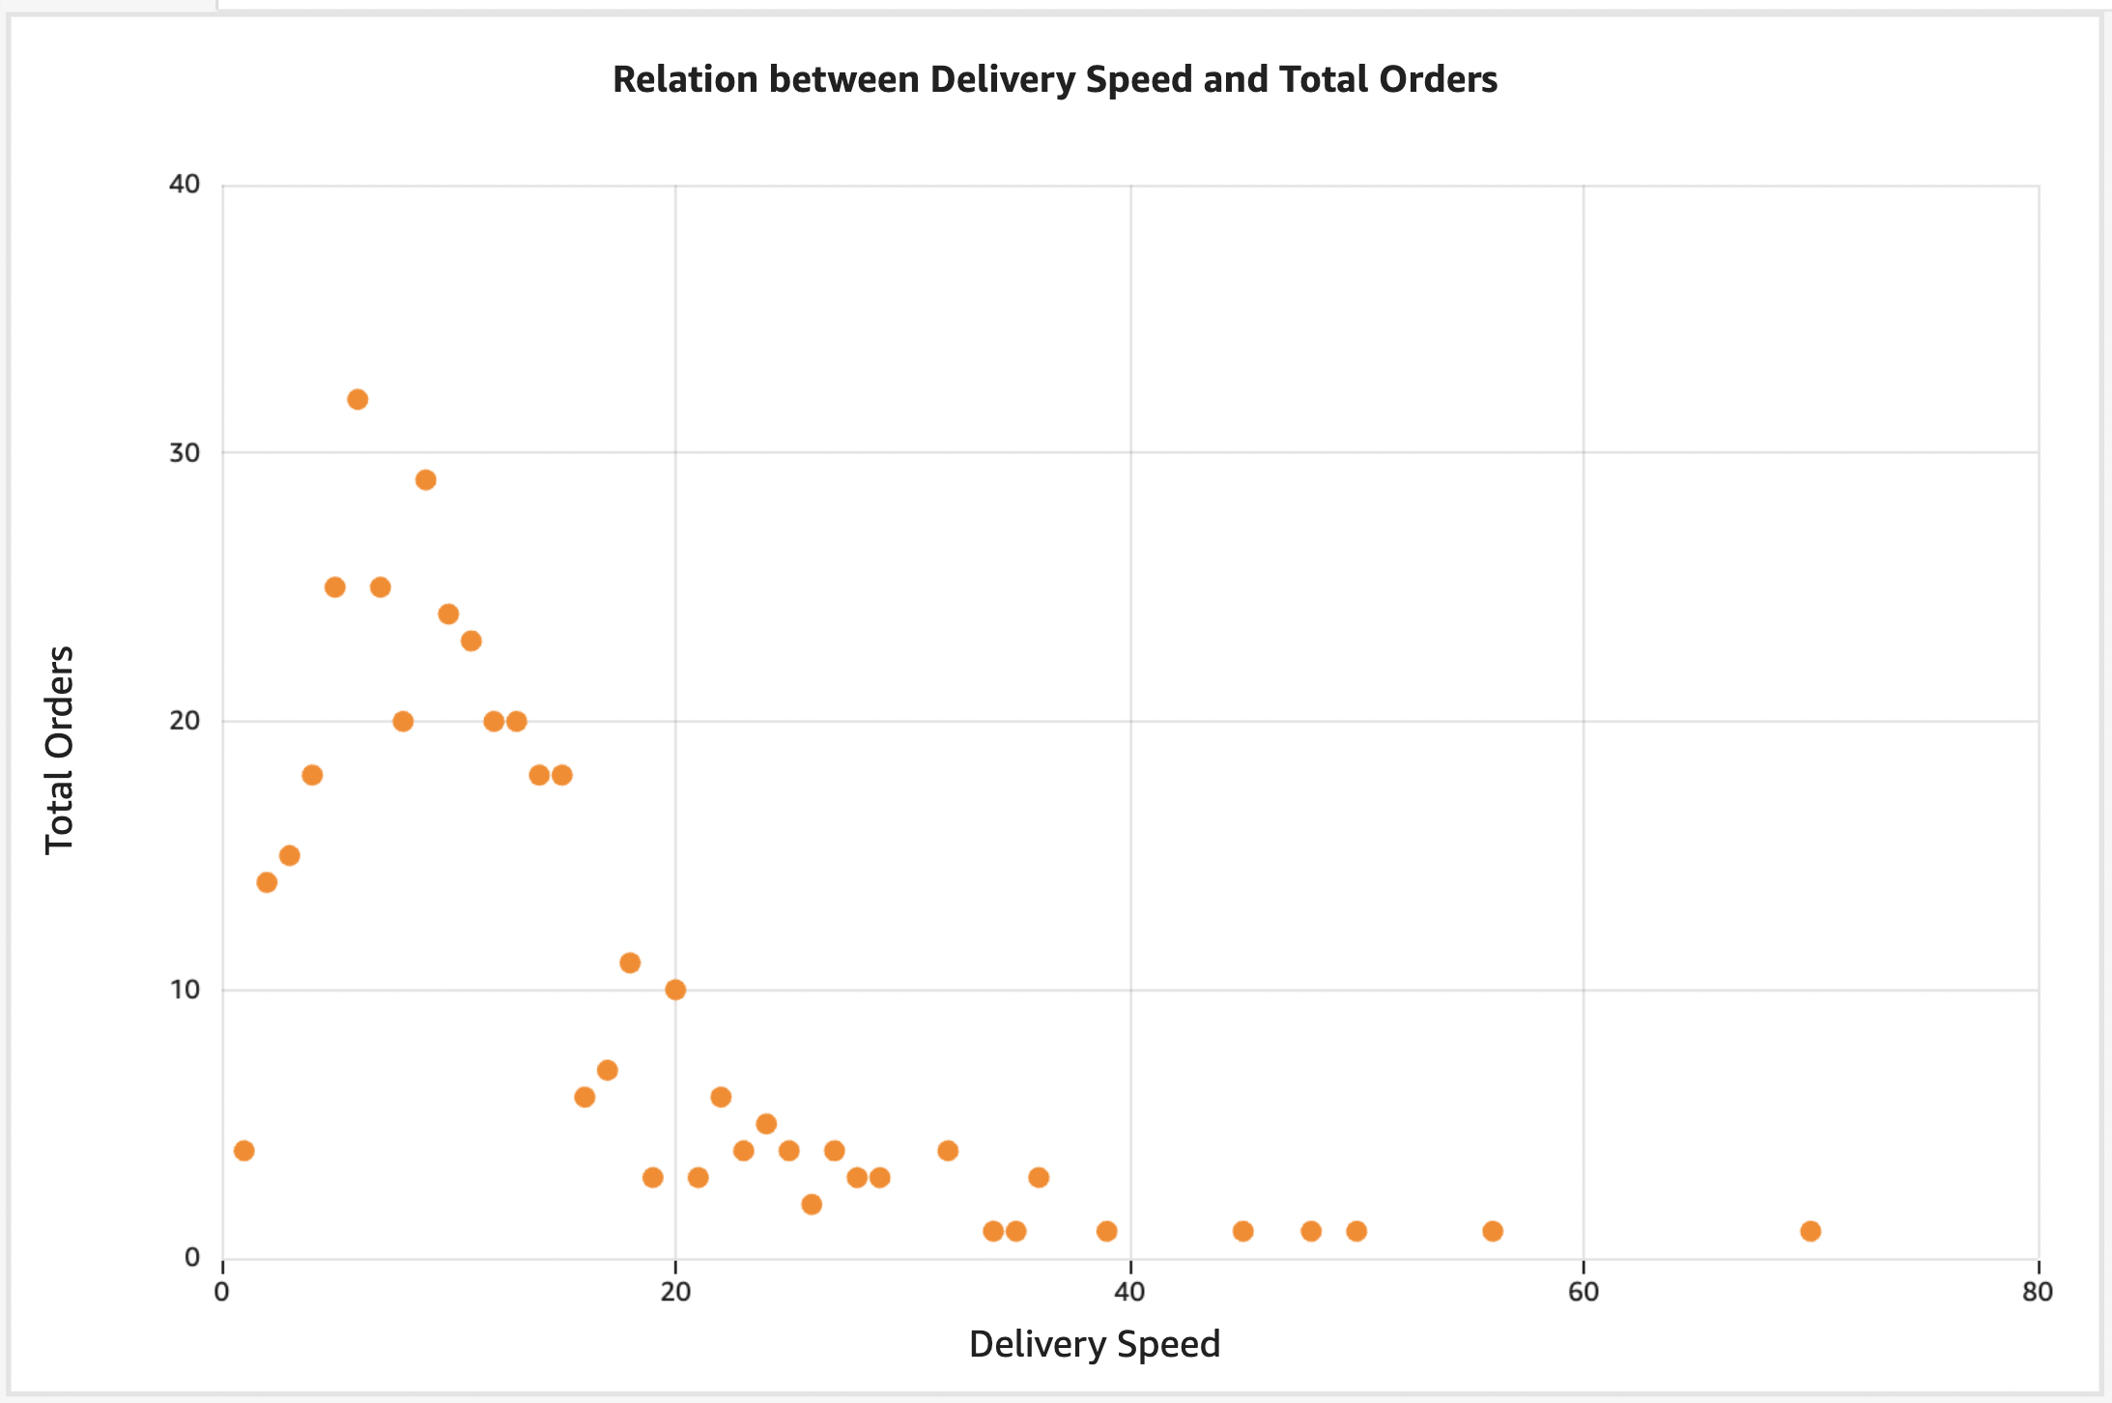
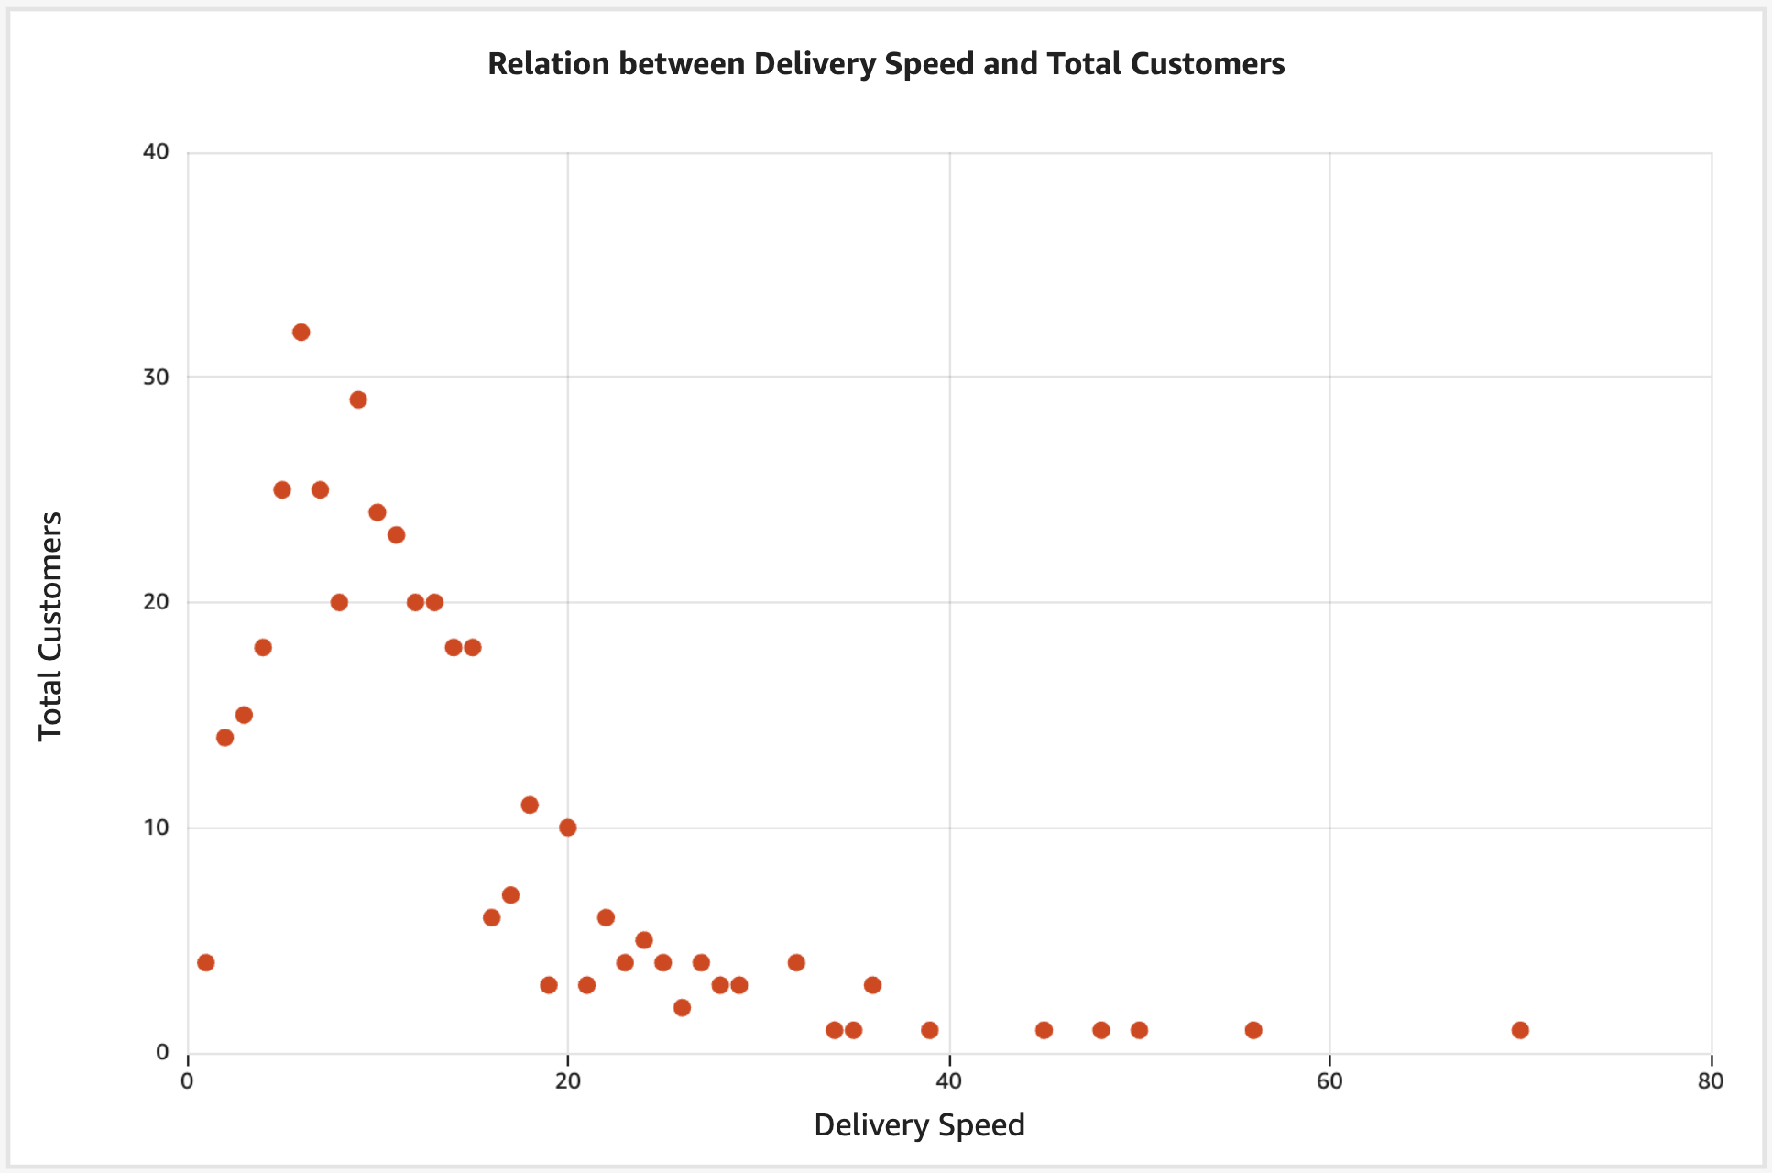
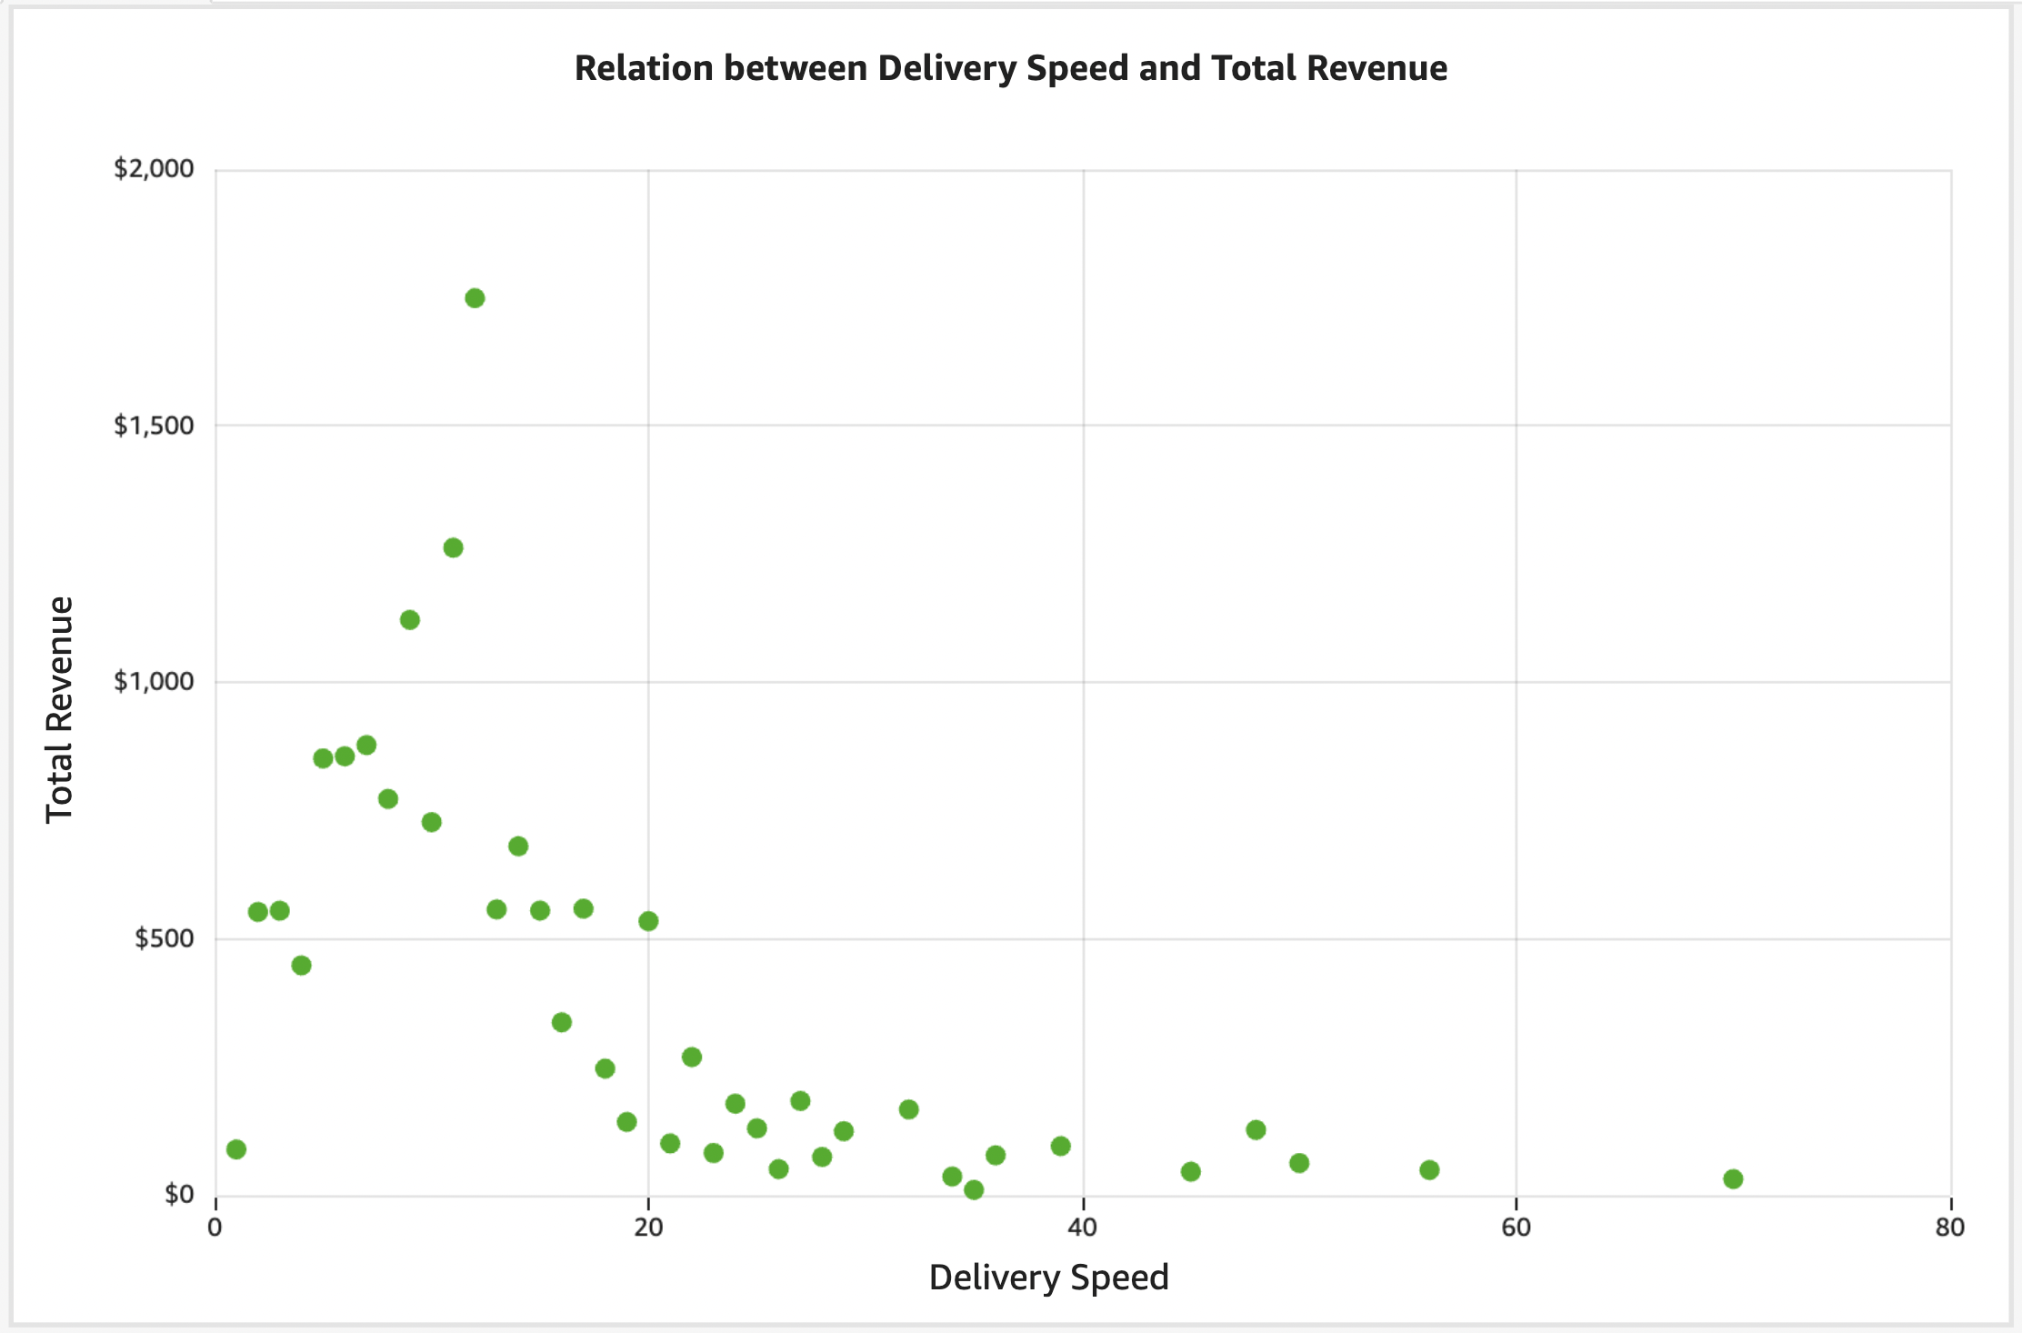
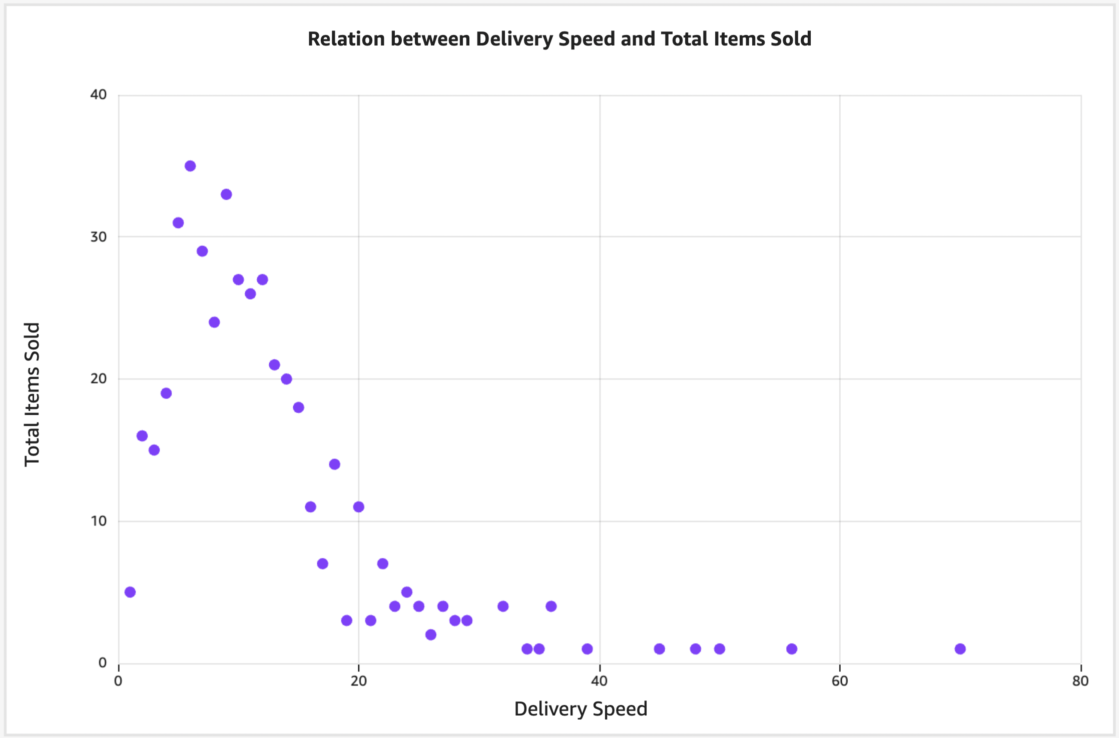
Delivery Speed Trends

Slide 14
The lack of clear trends in the scatter plots and the spread in the summary statistics suggest that delivery speed might not be the sole or even the primary factor affecting the number of orders, items sold, customers, or revenue.
There could be a variety of other influencing factors such as the type of products sold, customer preferences, time of year, or market competition.
Delivery Speed Insights

